Slide 1


Business Partner Analysis
with “Magist”
by Eniac
Is Magist a good partner for our high-end tech products?
Are their deliveries fast enough?
Group II / Robert Rommel – Murat Tüter – David Nutz – Sharon Schwaab

Slide 2
Is Magist a good business partner for us?
Based on our research, we recommend a reassessment in 6 months for the partnership, based the following points:
Magist does not have a big market for expensive tech products right now
Delivery reliability remains a potential operational risk because delayed orders experience substantial delays.

Slide 3
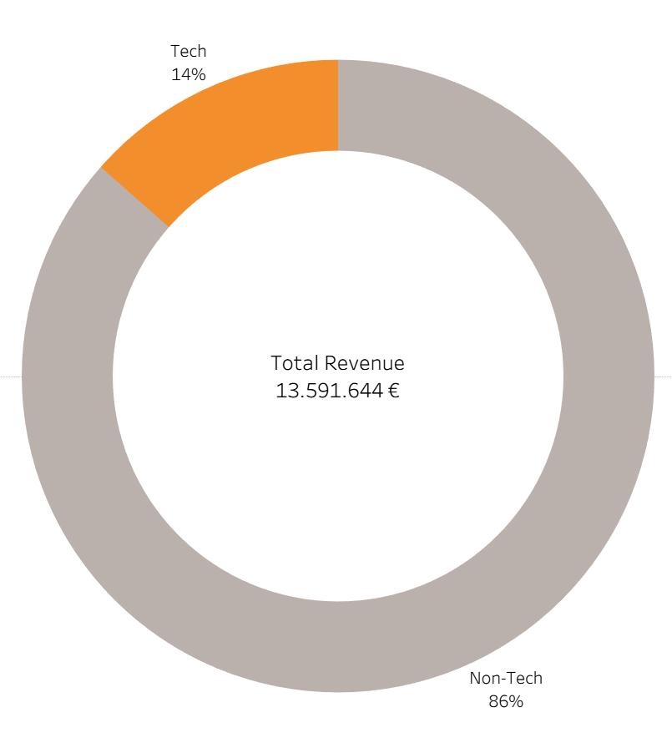
Revenue Tech vs Non-Tech
€13.6M total revenue
€1.84M from tech products
86% of revenue comes from non-tech products
Tech products contribute only 14% of total revenue
Notes:
Look at Magist’s total revenue
~ 13.6M€ total
roughly 1.84M€ is made out of tech
Tech is ~ 14%

Slide 4
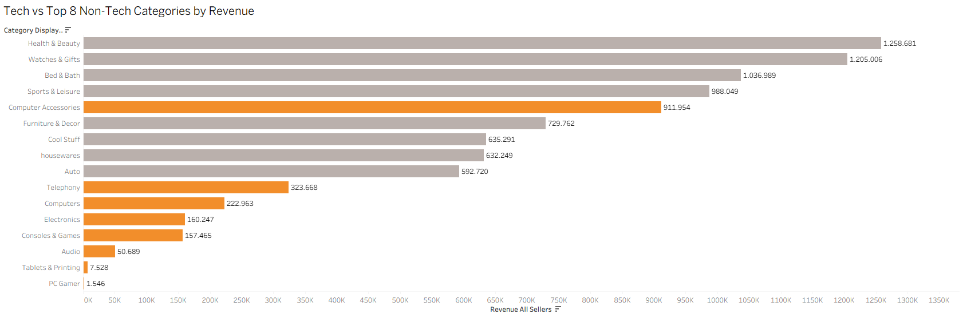
All Tech categories vs Top 8 Non-Tech Categories
Computer Accessories is the only tech category competing with top non-tech sellers.
All other tech categories generate <50% of the revenue of the 8th-largest non-tech category.
Notes:
Out of all categories 8 were put into the “tech” category
8 tech compared to the top 8 non-tech
There is a ~50% difference between the 8th placed non-tech and 2nd onwards tech

Slide 5
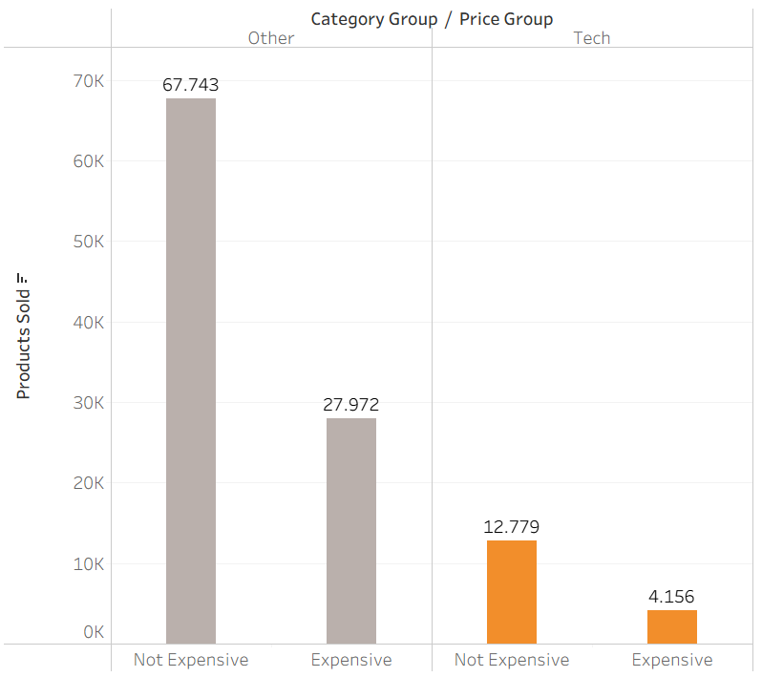
Non-Expensive vs Expensive Categories
Magist performs well in affordable Tech
Expensive Tech shows significantly lower sales volume
This may indicate a weak fit for Eniac's premium iPhone-focused portfolio
Magist's customer base appears more price-sensitive than premium-oriented
Premium Tech sells much less
This creates a potential market-fit risk for Eniac.

Slide 6
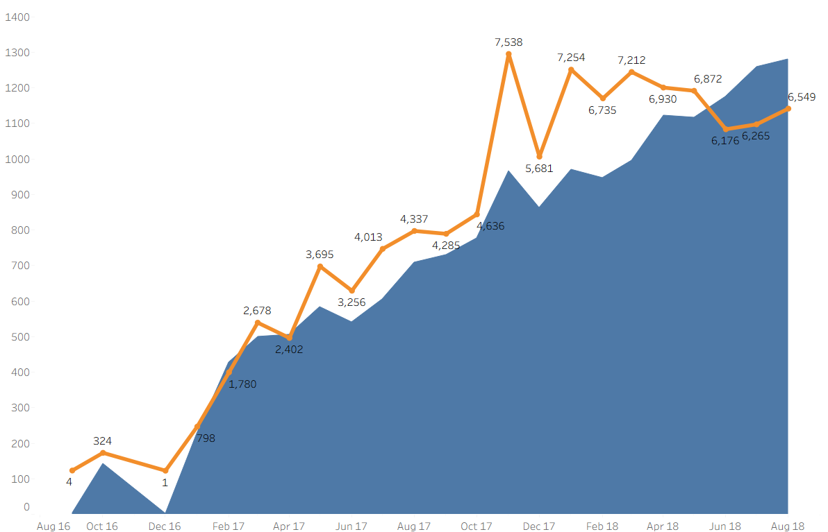

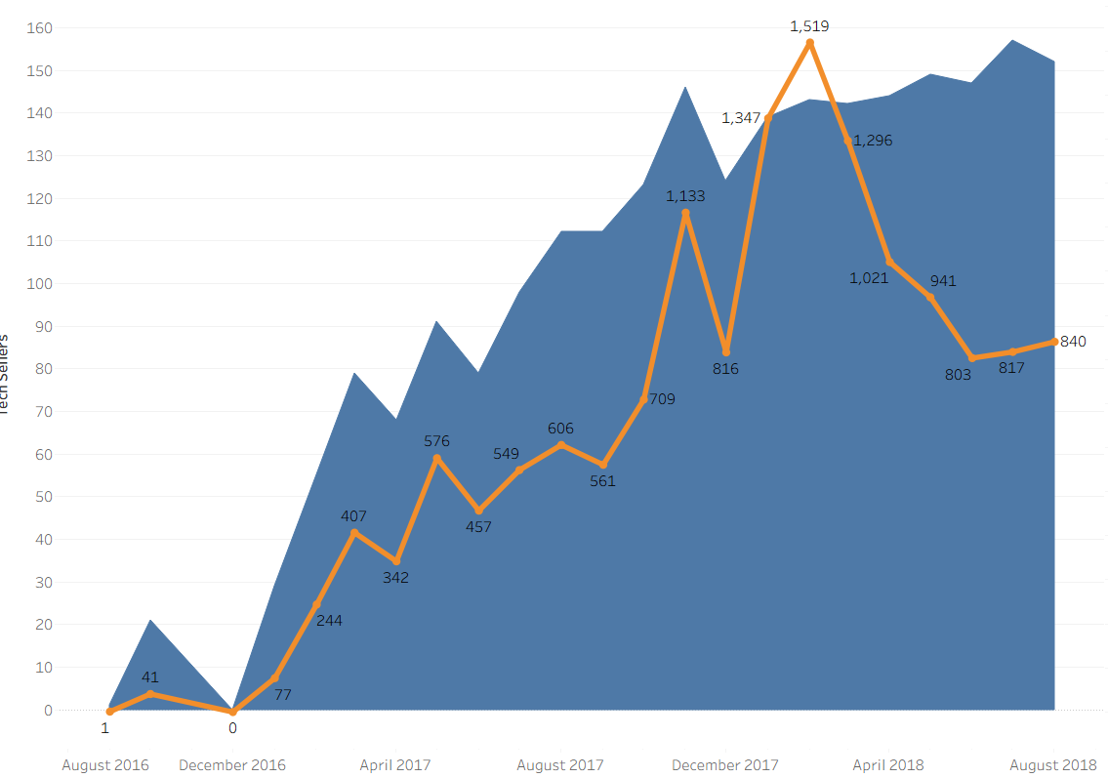

Sellers vs Orders
Magist shows steady increase on its seller base.
Total orders have shown a similar increase.
Orders stagneting after December 2017.
Tech sellers are growing similarly.
A sharp drop happening after the end of 2017 with no visible recovery.
An imbalance between sellers and buyers forming up
Indicating an unhealthy competition for Eniac.
Aug. 2018
Magist´s growth is driven by other categories and tech items are not a focus point on the booming buyer base.
Aug. 2018

Slide 7
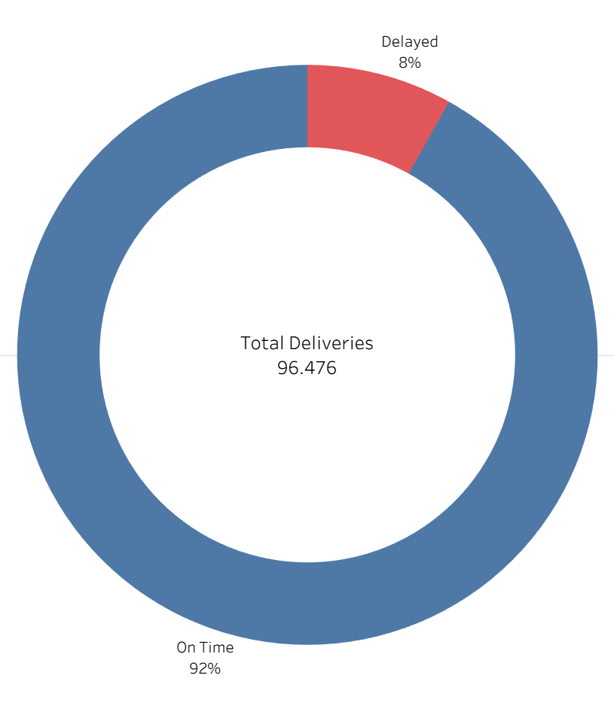
Percentage of delayed deliveries
92% on-time delivery across ~96.5K deliveries
~7.8k deliveries delayed, representing 8% of total
92% of deliveries arrived on time
8% deliveries are delayed

Slide 8
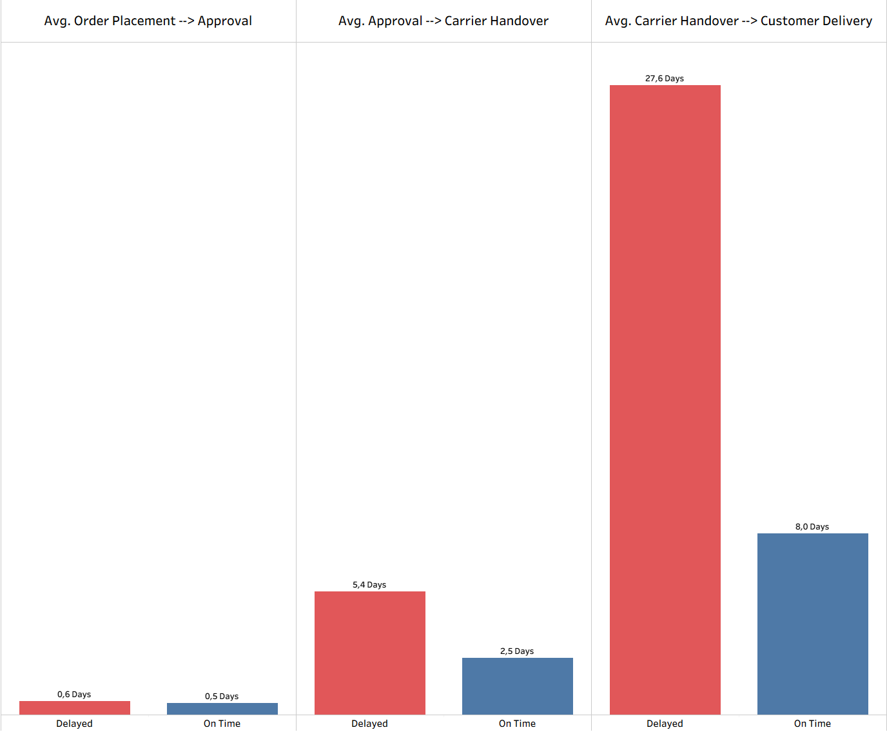
Average delay per Category
Two actors are major contributors to the delivery delays:
Eniac: Delays occur when handing the customer order over to the postal service
Postal service: Delays occur during the delivery of the order to the customer
Carrier service causes massive delays during the delivery process

Slide 9
Key Findings
Tech products performed worse than other product categories in recent months
The market for expensive tech products is relatively small
Delivery delays are often substantial rather than marginal
Recommendation: Reassess the partnership opportunity in 6 months

Slide 10
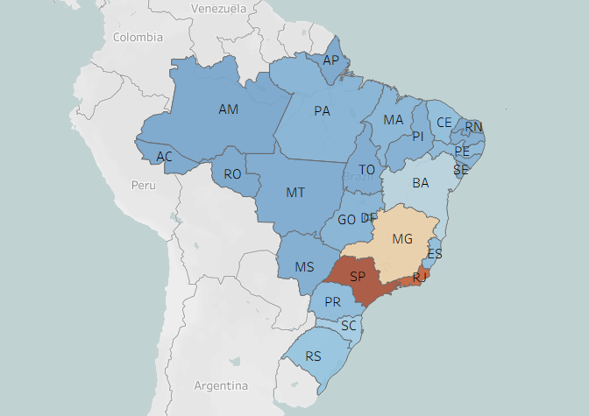

Slide 11
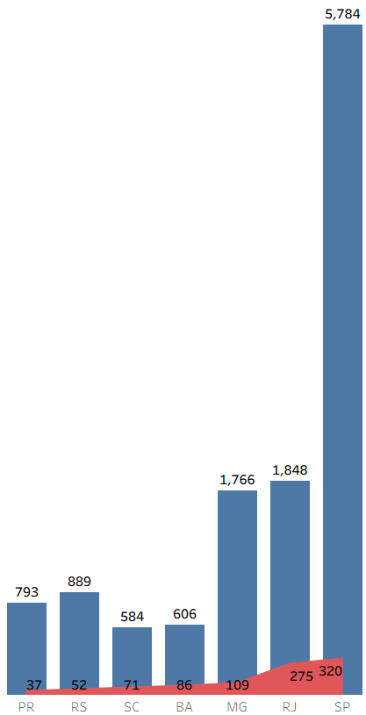
Delays by state vs total orders

Slide 12
Amount of (Tech-)Sellers vs Amount of (Tech-)Orders
Aug. 2018
Aug. 2018
Magist shows steady increase on its seller base
Total orders have shown a similar increase
Orders stagneting after December 2017
Tech sellers are growing similar to the total sellers.
A sharp drop after the end of 2017 with no visible recovery
Imbalance between sellers and buyers forming up
Indicating an unhealthy competition for Eniac
Magist´s growth is driven by other categories and tech items are not a focus point on the booming buyer and seller base.
A strong marketing and investment plan seems necessary from Magist focusing on tech categories.

Slide 13
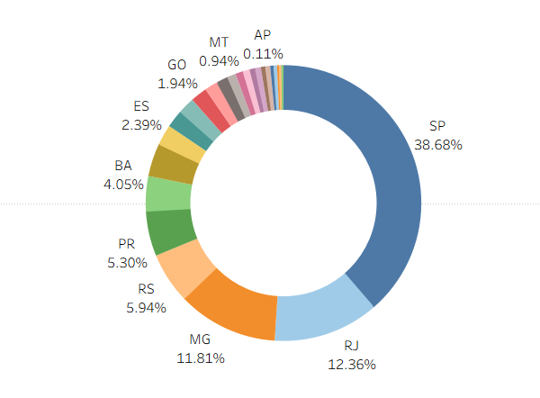

Slide 14
92% of deliveries arrived on time
92% on-time delivery across 96.5K deliveries
7.8k deliveries delayed, representing 8% of total
62% of al delays happened in just 3 states

Slide 15

Sellers vs Buyers
Magist shows steady increase on its seller base.
Total orders have shown a similar increase.
Orders stagneting after December 2017.
Tech sellers are growing similarly.
A sharp drop happening after the end of 2017 with no visible recovery.
Imbalance between sellers and buyers forming up
Indicating an unhealthy competition for Eniac.
Magist´s growth is driven by other categories and tech items are not a focus point on the booming buyer and seller base.
A strong marketing and investment plan seems necessary from Magist focusing on tech categories.

Slide 16
Sellers vs Orders Tech Category

Slide 18
A strong marketing and investment plan seems necessary from Magist focusing on tech categories.

